Slide 1
Guide to Networking Essentials,
6th Edition
Chapter 6: Network Reference Models and Standards

Slide 2
Objectives
Explain the OSI reference model layers and their relationship to hardware and software
Explain the IEEE 802 networking model and related standards
Copyright © 2012 Cengage Learning. All rights reserved.

Slide 3
Introducing the OSI and IEEE 802 Networking Models
Open Systems Interconnection (OSI) reference model proposed by the International Organization for Standardization (ISO) has become a key part of networking because it provides a common framework for developers and students of networking to work with and learn from
OSI model is not specific to any protocol suite and can be applied to most networking protocols
OSI model is a seven-layer organization of how data travels from place to place on any given network
Copyright © 2012 Cengage Learning. All rights reserved.

Slide 4
Role of a Reference Model
To see the value of a layered model outside the field of networking, look at this example of a letter being created, sent, and delivered by the US Postal Service
  The letter has to be written
  The letter has to be placed in an envelope and addressed in the correct format
  The local post office in the destination town has to sort the letter correctly for the right part of town
  The local carrier has to deliver the letter to the correct house
  The recipient has to receive the letter, open it, and read it
A layered approach to a complicated process reduces its complexity and turns it into a series of interconnected tasks
Copyright © 2012 Cengage Learning. All rights reserved.

Slide 5
Role of a Reference Model
Each task of the previous example can be handled separately without affecting the procedures of the other tasks.
  For example, in the step where the local carrier delivers the letter to the correct house:
    Let’s say he currently walks on his route, which takes a considerable amount of time
    He gets an “upgrade” to a delivery truck so that he can perform his task faster
    As you can see, one part of the process can change but the rest of the process remains unchanged
Copyright © 2012 Cengage Learning. All rights reserved.

Slide 6
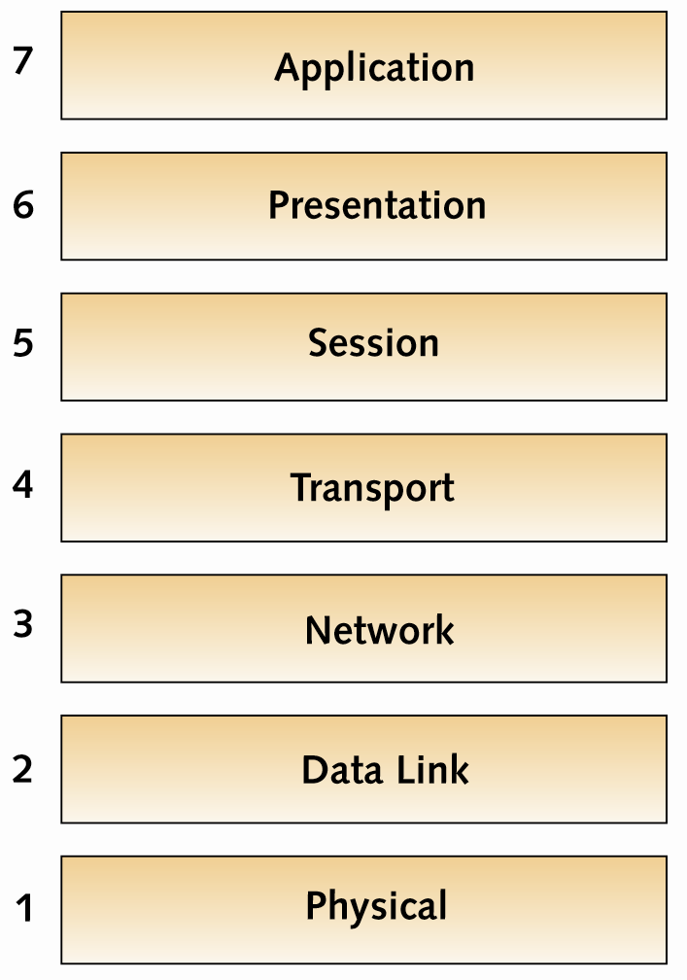
Structure of the OSI Model
Copyright © 2012 Cengage Learning. All rights reserved.

Slide 7
Structure of the OSI Model
Each layer in the OSI model has its own set of
well-defined functions
  The functions of each layer communicate and interact with the layers immediately above and below it
  Example: The Transport layer works with the Network layer below it and the Session layer above it
You were introduced to the TCP/IP model in previous chapters so the next slide will compare the two models
Copyright © 2012 Cengage Learning. All rights reserved.

Slide 8
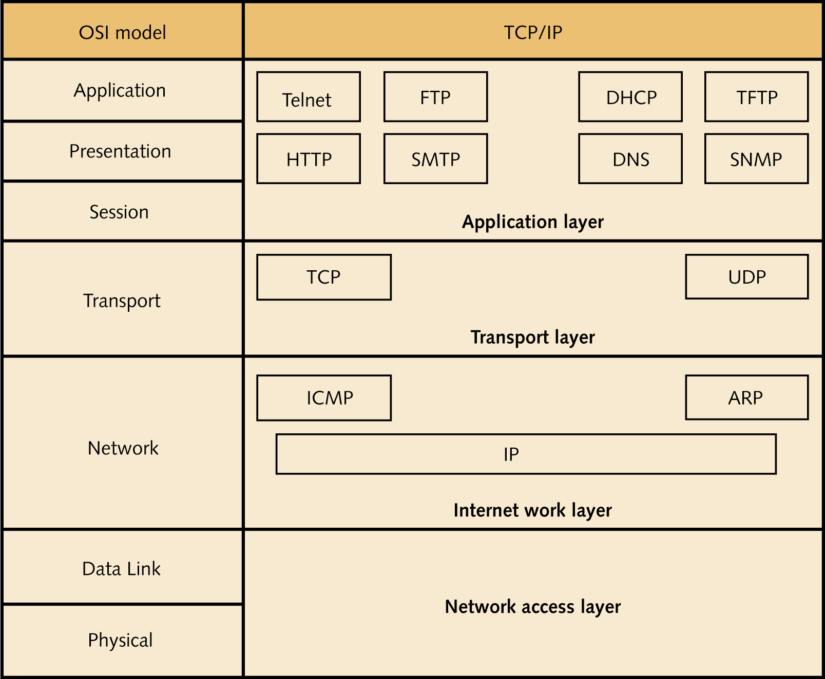
OSI Model VS TCP/IP Model
Copyright © 2012 Cengage Learning. All rights reserved.

Slide 9
Structure of the OSI Model
Each layer provides services to the next higher layer until the data reaches the Application layer
  Application layer has the job of providing services to user applications
Each layer on one computer behaves as though it were communicating with the same layer on the other computer
This is known as peer communication between layers
Simulation 11 – Peer communication with the OSI model
Copyright © 2012 Cengage Learning. All rights reserved.

Slide 10
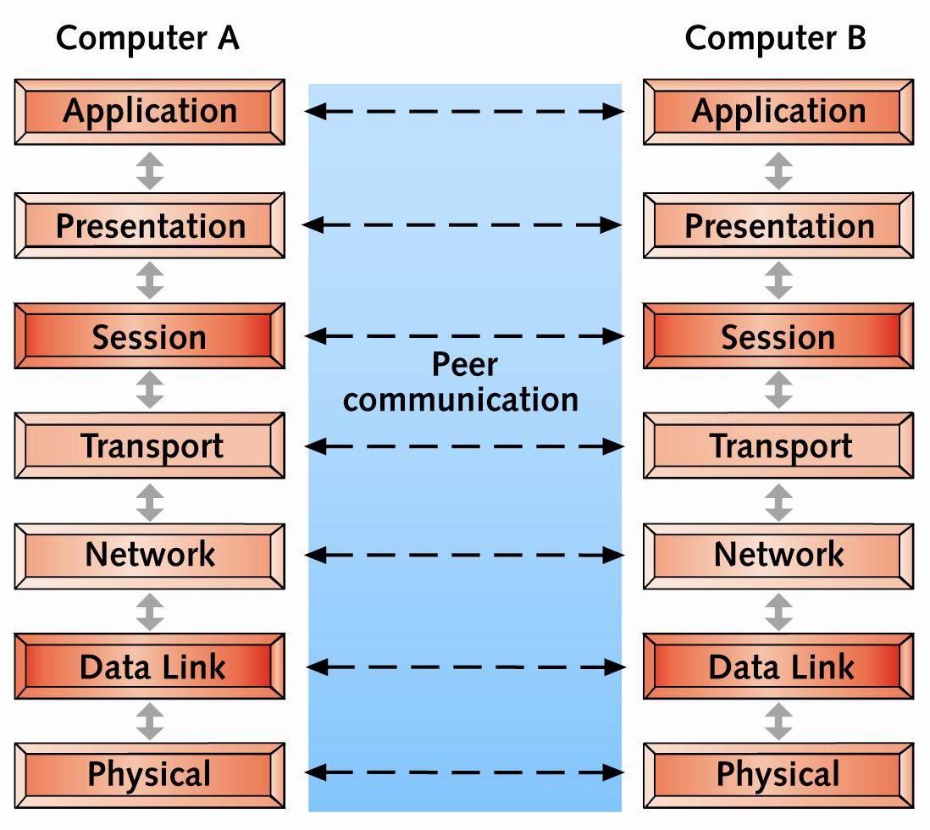
Structure of the OSI Model
Copyright © 2012 Cengage Learning. All rights reserved.

Slide 11
Structure of the OSI Model
On data’s way down the protocol stack (model), it is divided into data units called protocol data units (PDU)
Some layers add their own formatting to the PDU, which is called a header (encapsulation)
When data arrives at the receiving end, it is passed up the protocol stack
At each layer, software reads its PDU data and strips its header information (called deencapsulation) and passes the PDU to the next higher layer
When the packet leaves the Application layer, it is in a format the receiving application can read
Copyright © 2012 Cengage Learning. All rights reserved.

Slide 12
Application Layer
The Application layer (Layer 7) provides a set of interfaces for applications to access network services
Components at the Application layer have both a client component and a server component
Common protocols found at Layer 7 include HTTP, FTP, SMB/CIFS, TFTP, and SMTP
Possible problems at this layer include missing or misconfigured client or server software and incompatible or obsolete commands used to communicate between a client and server
Copyright © 2012 Cengage Learning. All rights reserved.

Slide 13
Presentation Layer
The Presentation layer (Layer 6) handles data formatting and translation
For outgoing messages
  Converts data into a format specified by the Application layer
For incoming messages
  Reverses the conversion if required by the receiving application
A software component known as a “redirector” operates at this layer
  Intercepts requests for service from the computer; requests that can’t be handled locally are redirected across the network to a network resource that can handle the request
Copyright © 2012 Cengage Learning. All rights reserved.

Slide 14
Session Layer
Session layer (Layer 5) permits two computers to hold ongoing communications, called a “session”
This layer handles communication setup ahead of data transfers and session teardown when the session ends
Common network functions at this layer:
  Name lookup, user logon and logoff
Manages the mechanics of ongoing conversations such as identifying which side can transmit data when and for how long
Checkpointing is performed at this layer
  Example: keeping the audio in sync with video
Copyright © 2012 Cengage Learning. All rights reserved.

Slide 15
Transport Layer
The Transport layer (Layer 4) manages data transfer from one application to another across a network by breaking data down into smaller chunks called “segments”
Segmenting data is important because every network technology has a maximum frame size called the maximum transmission unit (MTU)
Includes flow control and acknowledgments to ensure reliability
Handles resequencing segments into the original data on receipt
Copyright © 2012 Cengage Learning. All rights reserved.

Slide 16
Network Layer
The Network layer (Layer 3) handles logical addressing, translates logical network addresses (IP addresses) into physical addresses, and performs best path selection and routing in an internetwork
Access control is handled at this layer during the routing process
  The router consults a list of rules before forwarding an incoming packet to determine whether a packet meeting certain criteria should be permitted through
Software working at this layer include IP, ARP, and ICMP
Routers operate at this layer
Copyright © 2012 Cengage Learning. All rights reserved.

Slide 17
Data Link Layer
The Data Link layer (Layer 2) works with frames and is the intermediary between the Network layer and Physical layer
Defines how computers access the network medium (also called media access control)
  MAC address is defined at this layer
The software component operating at this layer is in the NIC driver
Hardware components that operate at this layer include NICs and switches
Problems at this layer include collisions and invalid frames
Simulation 9 – The changing frame header
Copyright © 2012 Cengage Learning. All rights reserved.

Slide 18
Physical Layer
The Physical layer (Layer 1) converts bits into signals for outgoing messages and signals into bits for incoming messages
  Wire media uses electrical pulses, fiber-optic uses light pulses and wireless media uses radio waves
Details for creating a physical network connection are specified at this layer
  Example: type of connectors used to attach the medium to the NIC
Encoding (representing 0s and 1s by a physical signal) happens at this layer
Components at this layer include all the cable and connectors used on the medium, repeaters and hubs
Copyright © 2012 Cengage Learning. All rights reserved.

Slide 19
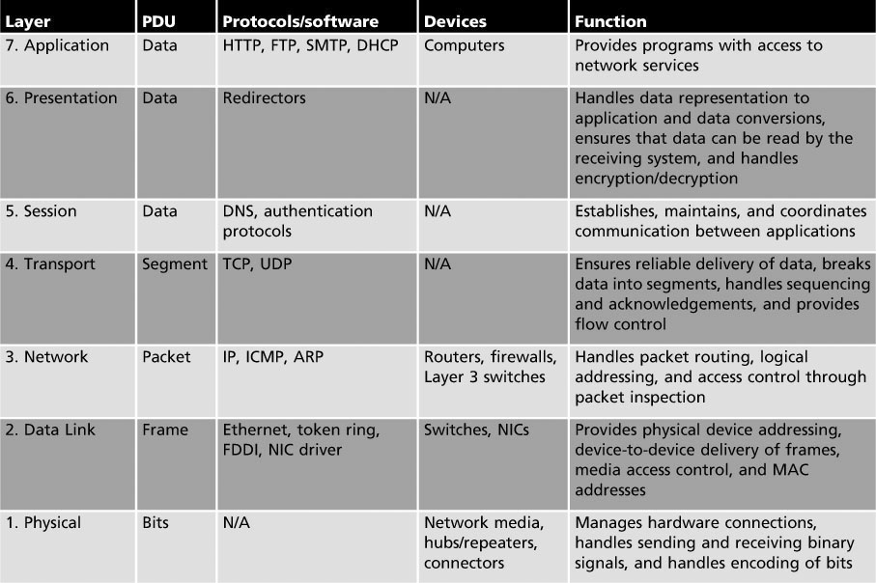
Summary of the OSI Model
Copyright © 2012 Cengage Learning. All rights reserved.

Slide 20
IEEE 802 Networking Standards
The Institute of Electrical and Electronics Engineers (IEEE) defined LAN standards to ensure that network interfaces and cabling from multiple manufacturers would be compatible
  This effort was called Project 802 to indicate the year (1980) and the month (Feb) of its inception
IEEE 802 predates the OSI Model
Most of the standards affect the elements from the lower two levels of the OSI Model
Describes how NICs can access and transfer data across a variety of networking media and what’s involved in attaching these devices in a network
Copyright © 2012 Cengage Learning. All rights reserved.

Slide 21
IEEE 802 Specifications
The IEEE numbers the collections of 802 documents starting with 802.1, 802.2, etc…
When a technology is enhanced, each enhancement is specified by letters after the number
  For example: 802.3 is the original Ethernet and 802.3u specifies 100BaseT Ethernet
The table on the next two slides lists the major 802 categories
  The 802.3 and 802.11 are the most widely used technologies as of this point
Copyright © 2012 Cengage Learning. All rights reserved.

Slide 22
IEEE 802 Specifications
Standard | Name | Explanation
802.1 | Internetworking | Covers routing, bridging, and internetwork communication
802.2 | Logical Link Control | Covers error control and flow control over data frames (inactive)
802.3 | Ethernet LAN | Covers all forms of Ethernet media and interfaces, from 10 Mbps to 10 Gbps (10 Gigabit Ethernet)
802.4 | Token Bus LAN | Covers all forms of token bus media and interfaces (disbanded)
802.5 | Token Ring LAN | Covers all forms of token ring media and interfaces
802.6 | Metropolitan Area Network | Covers MAN technologies, addressing, and services (disbanded)
802.7 | Broadband Technical Advisory Group | Covers broadband networking media, interfaces, and other equipment (disbanded)
802.8 | Fiber-Optic Technical Advisory Group | Covers use of fiber-optic media and technologies for various networking types (disbanded)
802.9 | Integrated Voice/Data Networks | Covers integration of voice and data traffic over a single network medium (disbanded)
802.10 | Network Security | Covers network access controls, encryption, certification, and other security topics (disbanded)
Copyright © 2012 Cengage Learning. All rights reserved.

Slide 23
IEEE 802 Specifications
802.11 | Wireless Networks | Sets standards for wireless networking for many different broadcast frequencies and techniques
802.12 | High-Speed Networking | Covers a variety of 100 Mbps-plus technologies, including 100VG-AnyLAN (disbanded)
802.13 | Unused
802.14 | Cable modems | Specifies data transport over cable TV (disbanded)
802.15 | Wireless PAN | Covers standards for wireless personal area networks
802.16 | Wireless MAN (WiMAX) | Covers wireless metropolitan area networks
802.17 | Resilient Packet Ring | Covers emerging standards for very high-speed, ring-based LANs and MANs
802.18 | Wireless Advisory Group | A technical advisory group that monitors radio-based wireless standards
802.19 | Coexistence Advisory Group | A group that addresses issues of coexistence with current and developing standards
802.20 | Mobile Broadband Wireless | A group working to enable always-on multivendor mobile broadband wireless access
802.21 | Media Independent Handoff | A group working to enable handoff between wireless networks of the same or different types
802.22 | Wireless Regional Area Network | Working to bring broadband access to hard-to-reach low-population areas
802.23 | Emergency Services Working Group | A new group (March 2010) working to facilitate civil authority communication systems
Copyright © 2012 Cengage Learning. All rights reserved.

Slide 24
IEEE 802 Extensions to the OSI Reference Model
The two lowest layers of the OSI model define how computers attach to specific network media and specify how more than one computer can access the network without causing interference with other computers on the network
The IEEE 802 specification expanded the OSI model by separating the Data Link layer into these sublayers:
  Logical Link Control (LLC) sublayer – controls data-link communication and defines the use of logical interface points used to communicate to the upper OSI layers
  Media Access Control (MAC) sublayer – manages access to the physical medium and communicates with the Physical layer
Copyright © 2012 Cengage Learning. All rights reserved.

Slide 25
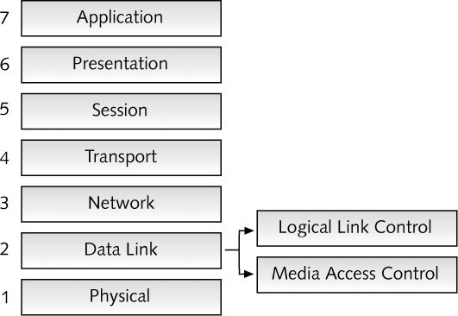
IEEE Extensions to the OSI Reference Model
Copyright © 2012 Cengage Learning. All rights reserved.

Slide 26
Chapter Summary
The OSI reference model and IEEE Project 802 define a frame of reference for networking and specify the operation of most networking technologies in current use
The OSI reference model separates networking into seven layers, each with its own purposes and activities
Following is a summary of the OSI Model layer functions:
  Application: Provides access to network resources
  Presentation: Handles data formatting and translation
  Session: Manages ongoing conversations between two computers
  Transport: Breaks long data streams into smaller chunks (segments)
Copyright © 2012 Cengage Learning. All rights reserved.

Slide 27
Chapter Summary
Summary of OSI Model layer functions (cont.):
  Network: Provides best path selection and IP addressing
  Data Link: Defines how computers access the media
  Physical: Converts bits into signals and defines media and connectors
The IEEE 802 project defines a set of networking standards to ensure that network interfaces and cabling from multiple manufacturers would be compatible. The IEEE 802.2 standard specifies a Logical Link Control (LLC) and Media Access Control (MAC) sublayer
Copyright © 2012 Cengage Learning. All rights reserved.

